Slide 1
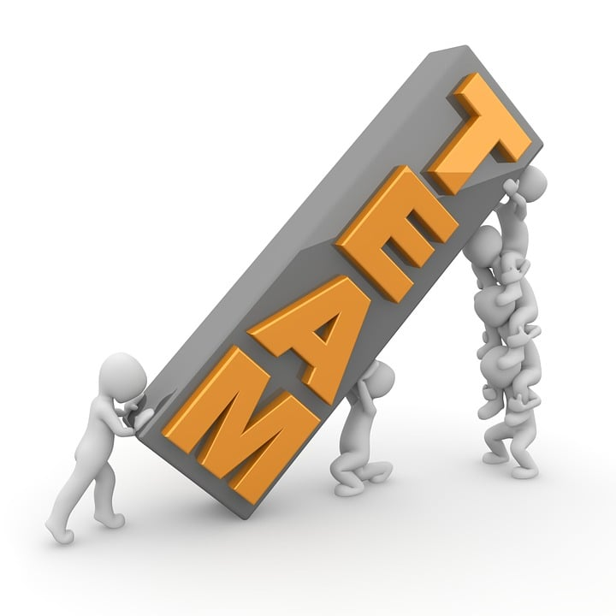

Team 4
1.Nishit Gaurang Shah - 130176217
2. Priyansh Parikh - 158341214
3. Yuvraj Singh - 156150211
4. Yash Padwani - 169914215

Slide 2
Introduction To Club-Hub Web Application

Slide 3
Problem Statement:
The Problem of: | Limited awareness and accessibility to diverse club activities within Maple Leaf Public School.
Affects: | Students, club organisers, and the school community
The impact of which is: | Reduced student engagement, missed opportunities for personal development, and a fragmented sense of community.
A successful solution would: | Improve awareness, streamline club participation, and strengthen the sense of community through enhanced communication and interaction.

Slide 4
Product Vision
For | Maple Leaf Public School students
Who | seek diverse extracurricular experiences,
Club-Hub | is a comprehensive web application
That | centralizes club information, events, and interactions.
Unlike | traditional methods,
Our product | provides a user-friendly interface, encourages active engagement, and fosters a sense of belonging through seamless integration with the school's homepage.

Slide 5
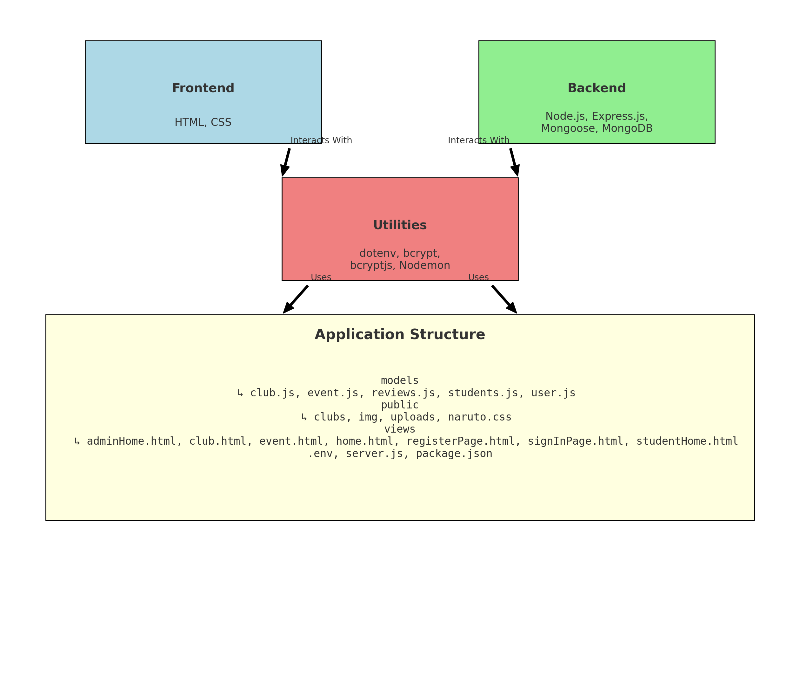
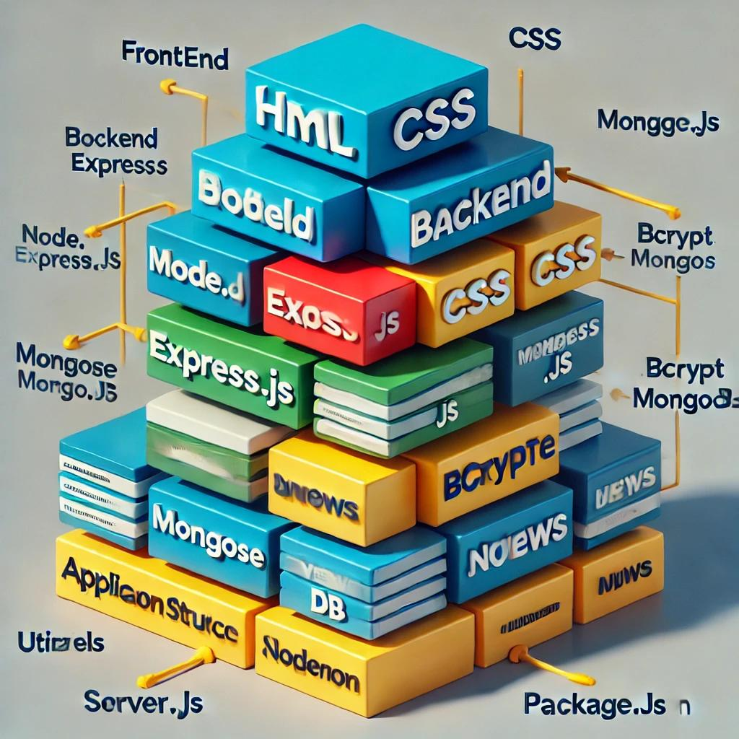
Architectural Description/stack diagram
Technology Stack: Frontend with HTML and CSS; Backend with Node.js, Express.js, and MongoDB via Mongoose; Utilities include dotenv, bcrypt, and Nodemon.
Application Structure: Models for data schema (club.js, user.js), Public for static files (CSS, images), Views for HTML pages (home.html, registerPage.html), Config with .env and server.js.
Component Interaction: Frontend interacts with Backend; Backend utilizes Utilities; Modular design ensures easy maintenance.
Data Flow: Frontend sends requests to Backend, which processes them using Utilities and interacts with MongoDB; Data is then returned to the Frontend.

Slide 6

Summary (Next Steps)
1. User Testing and Feedback Gathering
2. Deployment and Launch
3. Post-Launch Support and Maintenance
4. Continuous Improvement and Iteration
5. Community Engagement and Promotion
6. Evaluation and Assessment
7. Stakeholder Communication and Collaboration

